Slide 1

Presented by:
Sanjeeda Hossen
Instructor (AIDT)
Technical Teachers’ Training Collage

Slide 2
Link to Previous Session
Who can told me what we covered previous session?
Q 1.What do you mean by a PLAN? Q 2. What is the function of save commend?

Slide 3
Learning outcome
At the end of this session Learners will be able to draw a plan of a ‘stair case’ by using AutoCAD 2D software as per industry standard.

Slide 4

Structure
Stimulation

Slide 5
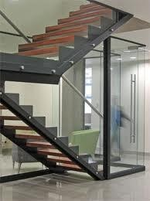
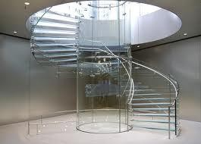
Discussion
Stair Case:“A Stair is a system of steps by which people and objects may pass from one level of a building to another.”
A stair is to be designed to span a large vertical distance by dividing it into smaller vertical distances, called steps.

Slide 6
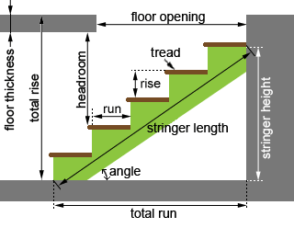
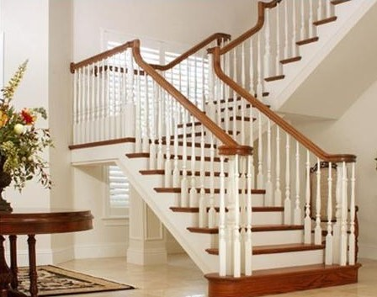
STAIR

Slide 7

PPE

Slide 8


Required Instrument
Sl. No: | Name of Instrument | Quantity
01 | Laptop/Monitor
02 | CPU
03 | Keyboard
04 | Mouse

Slide 9
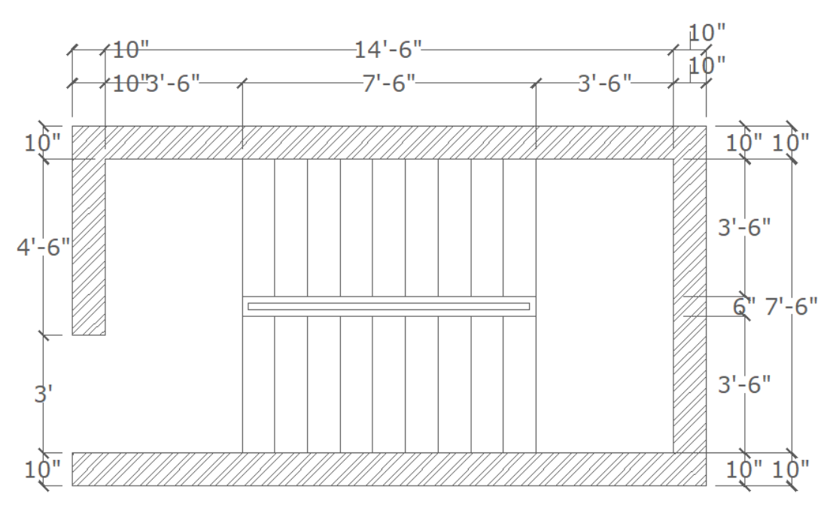
Demonestration
Practices time

Slide 10

Review & Feedback

Slide 11
Next Session
Draw a section of a stair case by using Auto CAD 2D as per industry standard.

Slide 12


